Slide 1

CS3700 Intro to Database & Modelling– Week 1
Data, Databases, DBMS and its architecture
Bibek Raj Joshi
Spring 2026

Slide 2
Software to Install Check
MariaDB
DBeaver

Slide 3
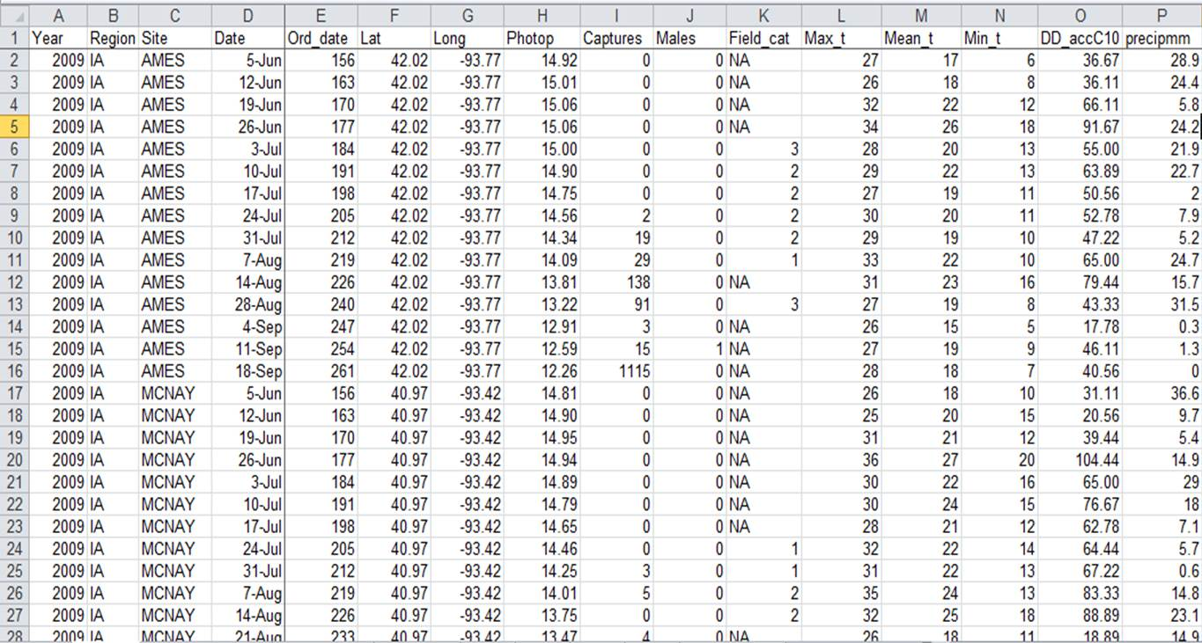
Data vs Information vs Database
Data:
  Raw facts
    Numbers
    Texts
    Measurements
  Example:
    101, Aang, 3.91, 2026-01-15
    By itself, data has no meaning

Slide 4
Data vs Information vs Database
Information:
  Processed, organized and contextualized data
  Now we can:
    Query
    Compare
    Reason
    Decide
Student ID | First Name | GPA | Enrollment Date
101 | Aang | 3.91 | 2026-01-15

Slide 5
Data vs Information vs Database
Database:
  A database is a shared, integrated, and locally related collection of data designed to meet the information needs of an organization. (Silberschatz et. al.)
  Key Properties
    Represents some aspect of the real world
    Is logically coherent
    Has inherent meaning
    Is designed for a specific purpose

Slide 6
Data vs Information vs Database
Example:
  University systems:
    Students, Courses, Instructor, Enrollments
  Netflix:
    Users, Movie, Watch History, Rating
  Amazon:
    Customers, Orders, Products, Payments

Slide 7
What is a DBMS
A Database Management System(DBMS) is a software that enables users to define, create, maintain, and control access to a database.
Functions:
  Data definition
  Data Storage
  Data Retrieval
  Security
  Integrity
  Concurrency
  Recovery
  We’re going to be using the combination of MariaDB + Dbeaver.

Slide 8
Database System != DBMS
A database system includes:
  The database
  DBMS software
  Application programs
  Users
  Hardware
  Procedures

Slide 9
Database System != DBMS
Real-world Database Applications:
  Banking Systems
  Airline Reservation Systems
  University System
  Hospital System
  E-commerce Platforms
  Social Media
  Government Records…et cetera.

Slide 10
File-Based Systems vs Databases
What is a File Processing System?
  Old:
    Each application manages its own files
    No central control
    No Global consistency
    Payroll app -> payroll.txt
    HR app -> employees.txt
    Registration app -> students.txt

Slide 11
Problems with File based systems
Data Redundancy: Same data stored in multiple places
Data Inconsistency: Copies disagree
Difficulty in access data
Integrity Problems
Atomicity problems
Concurrent Access anomalies: Users overwriting each other
Security problems: no centralized access control

Slide 12
How DBMS solves these?
Redundance → Centralized Data
Inconsistency → Single source of truth
Access → SQL
Integrity → Constraints
Atomicity →Transactions
Concurrency → Locking
Security → Roles & Privileges

Slide 13
Types of Database Users
Database Administrators(DBA)
  Define Schema
  Control authorization and security
  Performance tuning
  Backup & Recovery
  Storage management
  Monitoring usage
      The DBA is responsible for the overall control of the database system.

Slide 14
Types of Database Users
Database Designers
  Identify
    Data to store
    Relationships
    Constraints
  Work before any tables are created
  Use:
    Entity Relationship(ER) diagrams
    Conceptual Models

Slide 15
Types of Database Users
Application Programmers / Developers
  Write:
    Backend Code
    Web apps
    APIs
  Use:
    SQL Statements
    Object Relational Mapper (ORMs)
    Stored Procedures

Slide 16
Types of Database Users
End Users
  Naive/parametric users (e.g. bank teller, data entry clerk)
  Casual Users
  Sophisticated Users
  Standalone users

Slide 17
High-level DBMS Architecture
Users/Applications
SQL
Query Processor
Storage Manager
Disk Storage

Slide 18
Main DBMS Component
Query Processor
  Parsing SQL
  Optimizing queries
  Executing queries
Storage Manager
  Storing data on disk
  Retrieving data
  Managing files and indexes

Slide 19
Main DBMS Component
Transaction Manager
  Atomicity
  Consistency
  Isolation
  Durability
Authorization & Integrity Manager
  User permissions
  Constraints
  Keys
  Rules

Slide 20
The three-level architecture
Physical Level
How the Data is stored
Logical Level
What data is stored
Tables, attributes, relationships, constraints
View Level
What each users use
Subsets of data
Different representations
Files, pages, indexes, disk layout

Slide 21
Data Independence
Ability to change scheme at one level without affecting the next level up
Physical Data Independence
Change storage method without changing tables or program
Logical Data Independence
Change Logical schema without changing user views or applications.

Slide 22
Why This Architecture Matters
Scalability
Maintainability
Security
Performance tuning
Long system lifetime

Slide 23
finito

